Slide 1

Computer Organization and Assembly Language

Slide 2
Quiz 01

Slide 3

During Quiz !!!
Do your own work, Strict policy, Good Luck !!!

Slide 4
Q1: Given an assembly instruction in decimal (8130)₁₀ Convert & find its equivalent in hex & binary. (2pts)
Q2: What are the technical reasons behind architect developing multicore technology as compared to existing single core? Answer briefly. (2 pts)
Q3: Is assembly language platform dependent? Give reason for ur answer? (2 pts)
Q4: Assume Accumulator register and base register have values, AX= 1FC2H and BX=FF10H. (4 pts)
Write assembly language instruction to move contents of BX to AX? What would be value of both registers after above instruction execution?
Write AL instruction to overwrite lower 8 bits of BX by F9H? What would be final value of BX now?
Q5: Find address bits required for following memory sizes? a) 2048 bytes b) 8G Bytes (2 pts)
Good Luck ☺

Slide 5
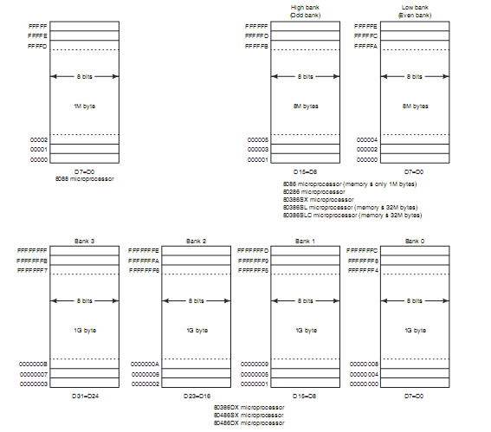
Memory mapping : banks

Slide 6
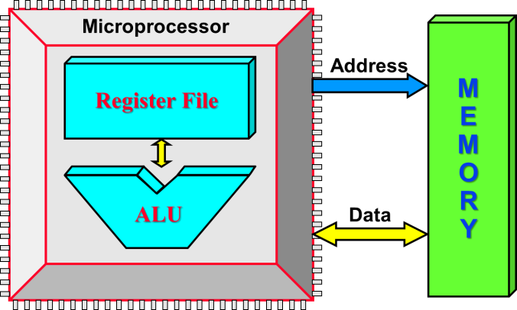
Multi purpose Registers :
 8 Bits 
 8 Bits 
Accumulator Register
AH
AL
AX
Base Register
BH
BL
BX
Count Register
CH
CL
CX
Division Register
DH
DL
DX

Slide 7
Multi purpose Registers :
Multipurpose registers:
8-bit register names used with register addressing: AH, AL, BH, BL, CH, CL, DH, and DL.
16-bit register names: AX, BX, CX, DX, SP, BP, SI, and DI.
80386 and above
32-bit register names are: EAX, EBX, ECX, EDX, ESP, EBP, EDI, and ESI.
64-bit mode register names are: RAX, RBX, RCX, RDX, RSP, RBP, RDI, RSI, and R8 through R15.
Note :Mixing of registers not allowed in assembler (Error)

Slide 8
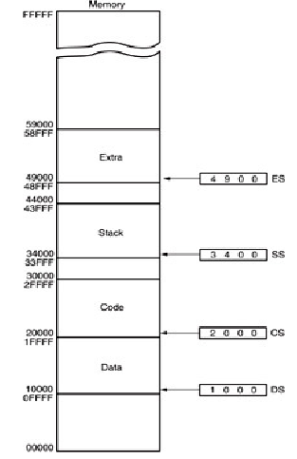
Multi purpose Registers :
←⎯ 16 Bits ⎯→
Code Segment
CS
Data Segment
DS
Extra Segment
ES
Stack Segment
SS

Slide 9
Instruction Format :
Instruction Format
Mnemonic /abbreviation
One or More Operands
Machine Code
Binary form 1 , 0’s
Mnemonic /
Abbreviation Operands
Opcode Mode Operands

Slide 10
Addressing modes

Slide 11

Book reading : Supplementary !!!
Topics covered in this lecture are from these texts.
Intel microprocessor 8th edition,Berry B.Bray
Chapter 3 Read 3.1 Addressing modes (relevant to slides only)
Tutorial 02 posted on group
Computer organizations,9th edition,William stallings.
Chapter Instruction sets: Addressing modes and format article name : Addressing modes
Tutorial 02 posted on group

Slide 12
Addressing Modes :
Without memory access:
Register-Register addressing
Immediate addressing
With memory access:
Direct data addressing
Indirect data addressing

Slide 13
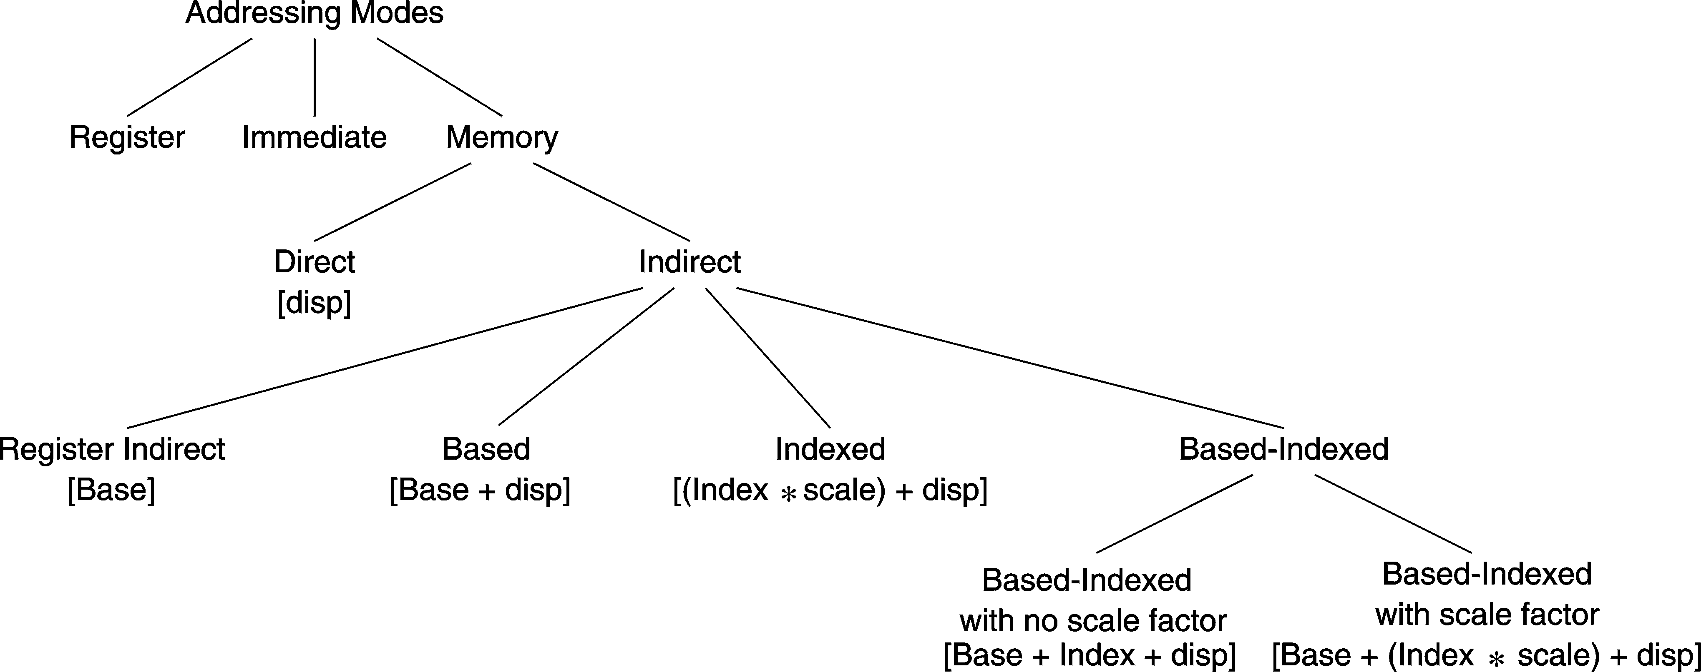
Layout of Addressing Modes
Assembler converts a variable name into a constant offset (called also a displacement)
For indirect addressing, a base/index register contains an address/index
CPU computes the effective address of a memory operand

Slide 14
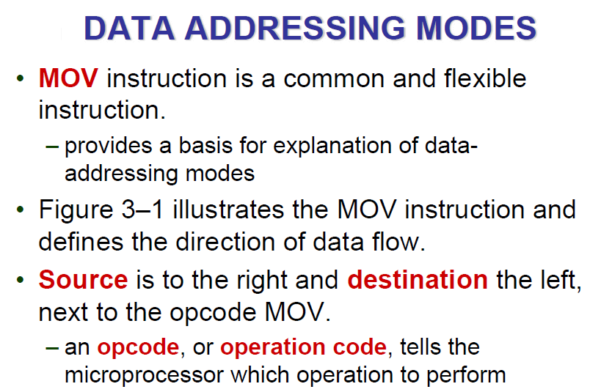
Mov instruction:

Slide 15
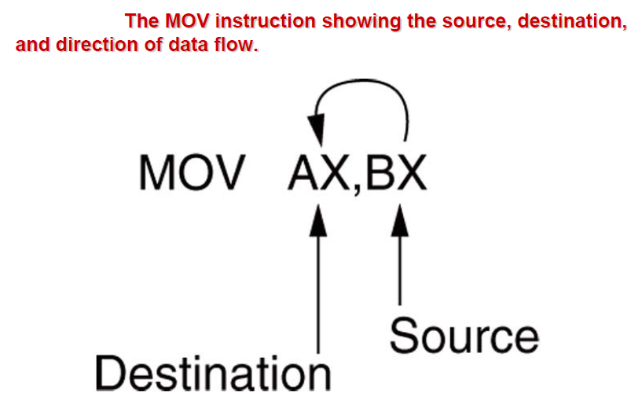
Example :

Slide 16
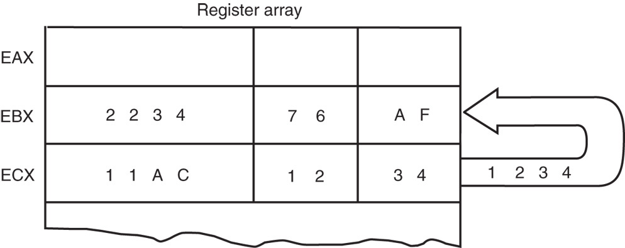
Register Addressing: Example
The source register’s contents do not change.
the destination register’s contents do change
The contents of the destination register or destination memory location change for all instructions except the CMP and TEST instructions.
Example:The MOV BX, CX instruction does not affect the leftmost 16 bits of register EBX.
Figure: The effect of executing the MOV BX, CX instruction at the point just before the BX register changes. Note that only the rightmost 16 bits of register EBX change.

Slide 17
Immediate Addressing :
Term immediate implies that data immediately follow the hexadecimal opcode in the memory.
immediate data are constant data
data is present in opcode/instruction.
Immediate addressing operates upon a byte or word of data.
Example :
MOV EAX,13456H

Slide 18
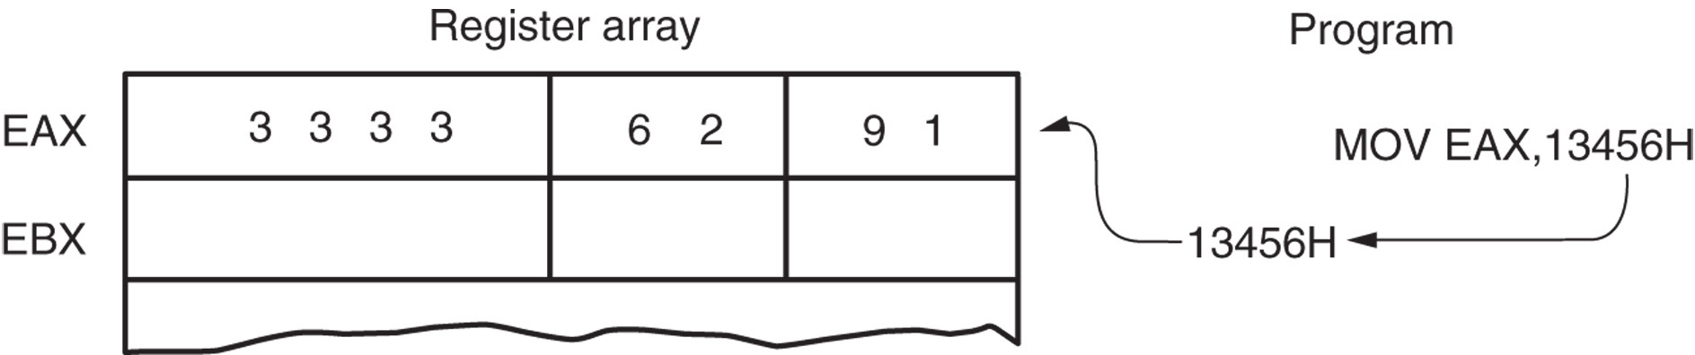
Immediate Addressing : Example
As with the MOV instruction illustrated in the following Figure, the source data overwrites the destination data.
Figure: The operation of the MOV EAX,13456H instruction. This instruction copies the immediate data (13456H) into EAX.

Slide 19
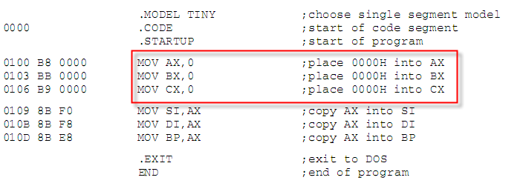
Immediate Addressing : Assembly Example
Immediate addressing used in assembly language program for …………….. ???

Slide 20
Direct data addressing : Displacement
Direct addressing with a MOV instruction transfers data between a memory location, located within the data segment, and registers ,the AL (8-bit), AX (16-bit), or EAX (32-bit) register or any other register in register file.
usually a 3-byte long instruction
Specifies operand as in memory whose location/address is specified by offset (displacement)
MOV AL,DATA loads AL from the data segment memory location DATA (1234H).
DATA is a symbolic memory location, while 1234H is the actual hexadecimal location

Slide 21
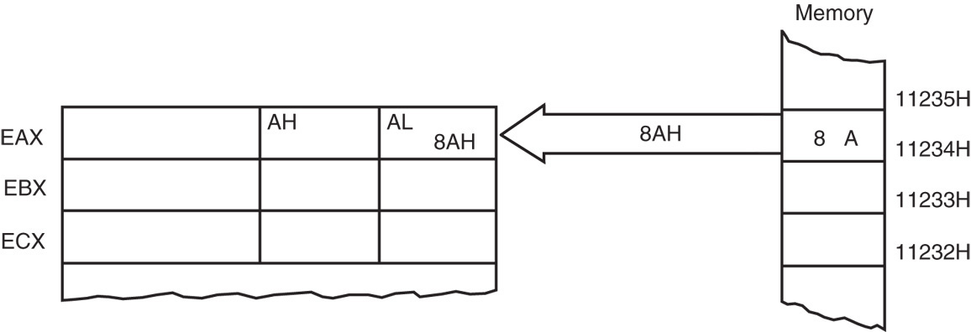
Direct data addressing : Displacement
Example:
MOV AL,[1234H]
MOV AL,DS:[1234H]
This instruction transfers a copy contents of memory location 11234H into AL.
the effective address is formed by adding 1234H (the offset address) and 10000H (the data segment address of 1000H times 10H) in a system operating in the real mode
Figure: The operation of the MOV AL,[1234H] instruction when DS=1000H .

Slide 22
Question : Direct Displacement addressing
What happens, if you wrote mistakenly
MOV AL,1234H instead of this MOV AL,[1234H] ?
Solution:
What this will do ? Can u guess ???
MOV [1234H] , AX
Solution: on next slide

Slide 23
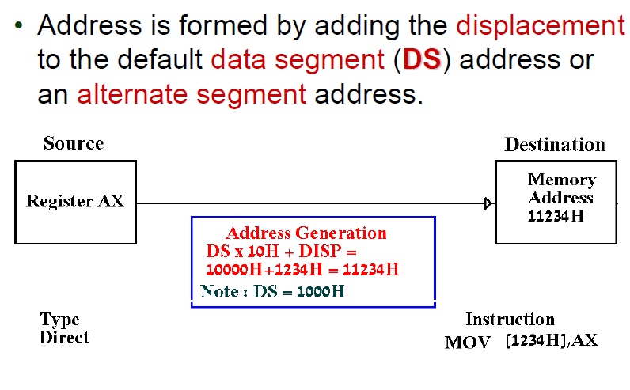
Solution : Direct Displacement addressing

Slide 24
Register Indirect addressing :
Involves data transfer between memory and registers.
The register value is used as a pointer to memory address. The operand is located at the memory address specified by the value of register.

Slide 25
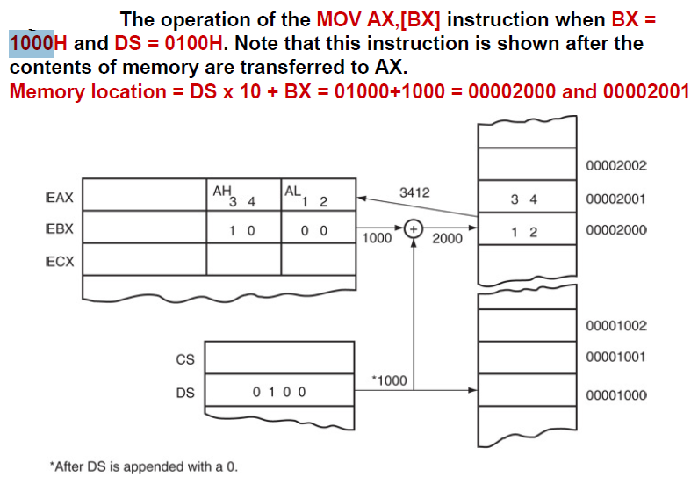
Example :

Slide 26
Absolute Addressing :
Similar to indirect but address of memory location is directly specified in opcode/instruction.
Example:
What if we remove the parenthesis ?What addressing mode will it become? Would it be an error?

Slide 27
Base-Plus-Index Addressing :
Similar to indirect addressing because it indirectly addresses memory data.
The base register often holds the beginning location of a memory array.
the index register holds the relative position of an element in the array
whenever BP addresses memory data, both the stack segment register and BP generate the effective address

Slide 28
Locating Data with Base-Plus-Index Addressing :
Figure in NEXT SLIDE shows how data are addressed by the MOV DX,[BX + DI] instruction when the microprocessor operates in the real mode.
The Intel assembler requires this addressing mode appear as [BX][DI] instead of [BX + DI].
The MOV DX,[BX + DI] instruction is MOV DX,[BX][DI] for a program written for the Intel ASM assembler.

Slide 29
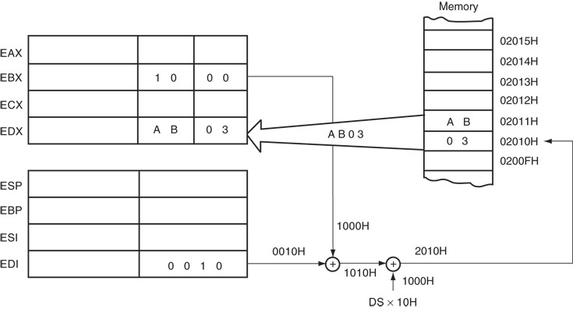
Locating Data with Base-Plus-Index Addressing
Figure: An example showing how the base-plus-index addressing mode functions for the MOV DX,[BX + DI] instruction. Notice that memory address 02010H is accessed because DS=0100H, BX=1000H and DI=0010H.

Slide 30
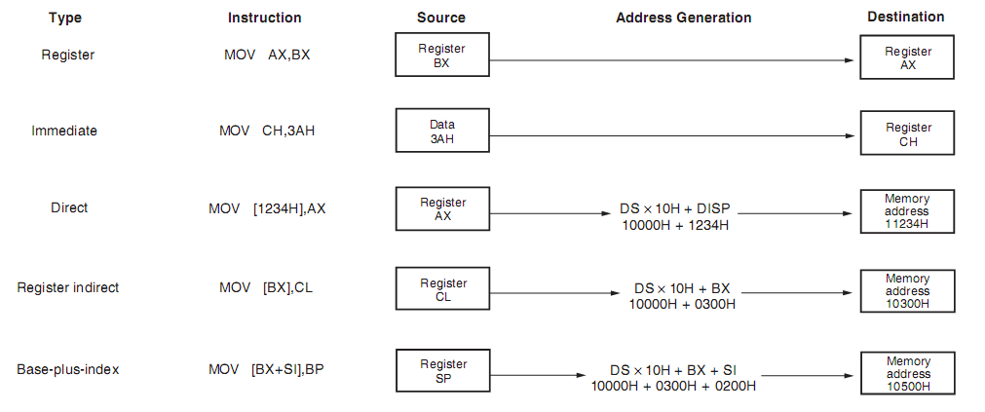
Summary of addressing modes !!!

Slide 31
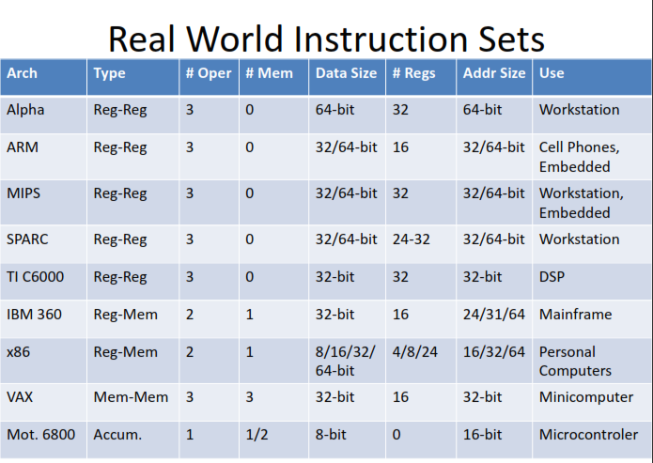
Question !!!
Why we studying different addressing mode

Slide 32
Thanks ALL

